Slide 1
SANER’17
Klagenfurt, Austria
Reducing Redundancies in Multi-Revision Code Analysis
Carol V. Alexandru, Sebastiano Panichella, Harald C. Gall
Software Evolution and Architecture Lab
University of Zurich, Switzerland
{alexandru,panichella,gall}@ifi.uzh.ch
22.02.2017

Slide 2
The Problem Domain
Static analysis (e.g. #Attr., McCabe, coupling...)

Slide 3
The Problem Domain
Static analysis (e.g. #Attr., McCabe, coupling...)
v0.7.0
v1.0.0
v1.3.0
v2.0.0
v3.0.0
v3.3.0
v3.5.0

Slide 4
The Problem Domain
Static analysis (e.g. #Attr., McCabe, coupling...)
Many revisions, fine-grained historical data
v0.7.0
v1.0.0
v1.3.0
v2.0.0
v3.0.0
v3.3.0
v3.5.0

Slide 5
A Typical Analysis Process
select project
www
clone

Slide 6
A Typical Analysis Process
select project
www
clone
select revision
checkout

Slide 7
A Typical Analysis Process
select project
www
clone
select revision
checkout
analysis tool
Res
apply
tool
store
analysis
results

Slide 8
A Typical Analysis Process
select project
www
clone
more revisions?
select revision
checkout
analysis tool
Res
apply
tool
store
analysis
results

Slide 9
A Typical Analysis Process
select project
www
more projects?
clone
more revisions?
select revision
checkout
analysis tool
Res
apply
tool
store
analysis
results

Slide 10
Redundancies all over...
Redundancies in historical code analysis
Impact on Code Study Tools

Slide 11
Redundancies all over...
Redundancies in historical code analysis
Across Revisions
Impact on Code Study Tools
Few files change
Only small parts of a file change

Slide 12
Redundancies all over...
Redundancies in historical code analysis
Across Revisions
Impact on Code Study Tools
Few files change
Repeated analysis of "known" code
Only small parts of a file change

Slide 13
Redundancies all over...
Redundancies in historical code analysis
Across Revisions
Impact on Code Study Tools
Few files change
Repeated analysis of "known" code
Only small parts of a file change
Changes may not even affect results
Storing redundant results

Slide 14
Redundancies all over...
Redundancies in historical code analysis
Across Revisions
Impact on Code Study Tools
Across Languages
Few files change
Repeated analysis of "known" code
Each language has their own toolchain
Only small parts of a file change
Yet they share many metrics
Changes may not even affect results
Storing redundant results

Slide 15
Redundancies all over...
Redundancies in historical code analysis
Across Revisions
Impact on Code Study Tools
Across Languages
Few files change
Repeated analysis of "known" code
Each language has their own toolchain
Only small parts of a file change
Re-implementing identical analyses
Yet they share many metrics
Changes may not even affect results
Generalizability is expensive
Storing redundant results

Slide 16
Redundancies all over...
Redundancies in historical code analysis
Across Revisions
Impact on Code Study Tools
Across Languages
Most tools are specifically made for analyzing 1 revision in 1 language
Few files change
Repeated analysis of "known" code
Each language has their own toolchain
Only small parts of a file change
Re-implementing identical analyses
Yet they share many metrics
Changes may not even affect results
Generalizability is expensive
Storing redundant results

Slide 17
Important!
Techniques implemented in LISA
Your favourite analysis features
Pick what you like!

Slide 18
#1: Avoid Checkouts

Slide 19
Avoid checkouts
clone

Slide 20
Avoid checkouts
clone
checkout
read
write

Slide 21
Avoid checkouts
analyze
clone
read
checkout
read
write

Slide 22
Avoid checkouts
analyze
clone
read
checkout
read
write
For every file: 2 read ops + 1 write op
Checkout includes irrelevant files
Need 1 CWD for every revision to be analyzed in parallel

Slide 23
Avoid checkouts
clone
analyze
read

Slide 24
Avoid checkouts
Only read relevant files in a single read op
No write ops
No overhead for parallization
clone
analyze
read

Slide 25
Avoid checkouts
Only read relevant files in a single read op
No write ops
No overhead for parallization
clone
analyze
Analysis Tool
File Abstraction Layer
Git
read

Slide 26
Avoid checkouts
Only read relevant files in a single read op
No write ops
No overhead for parallization
clone
analyze
Analysis Tool
File Abstraction Layer
Git
read
E.g. for the JDK Compiler:
class JavaSourceFromCharrArray(name: String, val code: CharBuffer)
extends SimpleJavaFileObject(URI.create("string:///" + name), Kind.SOURCE) {
override def getCharContent(): CharSequence = code
}

Slide 27
Avoid checkouts
Only read relevant files in a single read op
No write ops
No overhead for parallization
The simplest time-saver:
If you can - operate directly on bare Git
clone
analyze
Analysis Tool
File Abstraction Layer
Git
read
E.g. for the JDK Compiler:
class JavaSourceFromCharrArray(name: String, val code: CharBuffer)
extends SimpleJavaFileObject(URI.create("string:///" + name), Kind.SOURCE) {
override def getCharContent(): CharSequence = code
}

Slide 28
#2: Use a multi-revision representation
of your sources

Slide 29
Merge ASTs
rev. 1
rev. 2
rev. 3
rev. 4

Slide 30
Merge ASTs
rev. 1
rev. 2
rev. 1
rev. 3
rev. 4

Slide 31
Merge ASTs
rev. 1
rev. 2
rev. 2
rev. 3
rev. 4

Slide 32
Merge ASTs
rev. 1
rev. 2
rev. 3
rev. 3
rev. 4

Slide 33
Merge ASTs
rev. 1
rev. 2
rev. 4
rev. 3
rev. 4

Slide 34
Merge ASTs
rev. 1
rev. 2
rev. 3
rev. 4

Slide 35
Merge ASTs
rev. 1
rev. range [1-4]
rev. 2
rev. 3
rev. range [1-2]
rev. 4

Slide 36
Merge ASTs
rev. 1
rev. 2
rev. 3
rev. 4
AspectJ (~440k LOC):
1 commit: 2.2M nodes
All >7000 commits: 6.5M nodes

Slide 37
Merge ASTs
rev. 1
rev. 2
Merging ASTs brings exponential
space and time savings
rev. 3
rev. 4
AspectJ (~440k LOC):
1 commit: 2.2M nodes
All >7000 commits: 6.5M nodes

Slide 38
Merge ASTs
rev. 1
rev. 2
PS: Analyzing multiple revisions implies building a graph of all revisions first, and analyzing it afterwards
rev. 3
rev. 4
AspectJ (~440k LOC):
1 commit: 2.2M nodes
All >7000 commits: 6.5M nodes

Slide 39
#3: Store AST nodes only if
they're needed for analysis

Slide 40
public class Demo {
public void run() {
for (int i = 1; i< 100; i++) {
if (i % 3 == 0 || i % 5 == 0) {
System.out.println(i)
}
}
}
What's the complexity (1+#forks) and name for each method and class?

Slide 41
public class Demo {
public void run() {
for (int i = 1; i< 100; i++) {
if (i % 3 == 0 || i % 5 == 0) {
System.out.println(i)
}
}
}
What's the complexity (1+#forks) and name for each method and class?
parse
140 AST nodes
(using ANTLR)

Slide 42
public class Demo {
public void run() {
for (int i = 1; i< 100; i++) {
if (i % 3 == 0 || i % 5 == 0) {
System.out.println(i)
}
}
}
What's the complexity (1+#forks) and name for each method and class?
parse
CompilationUnit
TypeDeclaration
Members
Name
Modifiers
Method
Demo
public
Body
Parameters
Name
Modifiers
ReturnType
Statements
...
run
public
PrimitiveType
...
VOID
140 AST nodes
(using ANTLR)

Slide 43
public class Demo {
public void run() {
for (int i = 1; i< 100; i++) {
if (i % 3 == 0 || i % 5 == 0) {
System.out.println(i)
}
}
}
What's the complexity (1+#forks) and name for each method and class?
parse
filtered parse
TypeDeclaration
Method
Name
ForStatement
Name
Demo
IfStatement
run
ConditionalExpression
140 AST nodes
(using ANTLR)
7 AST nodes
(using ANTLR)

Slide 44
public class Demo {
public void run() {
for (int i = 1; i< 100; i++) {
if (i % 3 == 0 || i % 5 == 0) {
System.out.println(i)
}
}
}
What's the complexity (1+#forks) and name for eachmethod and class?
parse
filtered parse
TypeDeclaration
Storing only needed AST nodes applies a manyfold reduction in needed space
Method
Name
ForStatement
Name
Demo
IfStatement
run
ConditionalExpression
140 AST nodes
(using ANTLR)
7 AST nodes
(using ANTLR)

Slide 45
public class Demo {
public void run() {
for (int i = 1; i< 100; i++) {
if (i % 3 == 0 || i % 5 == 0) {
System.out.println(i)
}
}
}
What's the complexity (1+#forks) and name for eachmethod and class?
parse
filtered parse
TypeDeclaration
PS: Which AST nodes to load into the graph depends on the analysis
Method
Name
ForStatement
Name
Demo
IfStatement
run
ConditionalExpression
140 AST nodes
(using ANTLR)
7 AST nodes
(using ANTLR)

Slide 46
#4: Use non-duplicative data structures
to store your results

Slide 47
rev. 1
rev. 2
rev. 3
rev. 4

Slide 48
rev. 1
rev. 2
rev. 3
rev. 4

Slide 49
rev. 1
rev. 2
rev. 3
rev. 4
[1-1]
label
#attr
mcc
[2-3]
label
#attr
mcc
[4-4]
label
#attr
mcc
InnerClass
0
4
1
2
4

Slide 50
rev. 1
rev. 2
Many entities can share the same data across 1000s of revisions
rev. 3
rev. 4
[1-1]
label
#attr
mcc
[2-3]
label
#attr
mcc
[4-4]
label
#attr
mcc
InnerClass
0
4
1
2
4

Slide 51
LISA also does:
#5: Parallel Parsing
#6: Asynchronous graph computation
#7: Generic graph computations
applying to ASTs from compatible
languages

Slide 52
To Summarize...

Slide 53
The LISA Analysis Process
select project
www
clone

Slide 54
The LISA Analysis Process
select project
www
clone
Generates Parser
parallel parse
into merged
graph
determines which AST
nodes are loaded
ANTLRv4
Grammar
Language Mappings
(Grammar to Analysis)
used by

Slide 55
The LISA Analysis Process
select project
www
Async. compute
clone
Res
parallel parse
into merged
graph
store
analysis
results
Generates Parser
runs
on graph
determines which AST
nodes are loaded
determines which
data is persisted
ANTLRv4
Grammar
Language Mappings
(Grammar to Analysis)
Analysis formulated as Graph Computation
used by
used by

Slide 56
The LISA Analysis Process
select project
more projects?
www
Async. compute
clone
Res
parallel parse
into merged
graph
store
analysis
results
Generates Parser
runs
on graph
determines which AST
nodes are loaded
determines which
data is persisted
ANTLRv4
Grammar
Language Mappings
(Grammar to Analysis)
Analysis formulated as Graph Computation
used by
used by

Slide 57
How well does it work, then?

Slide 58
Marginal cost for +1 revision
Seconds
# of revisions

Slide 59
Overall Performance Stats
Language | Java | C# | JavScript
#Projects | 100 | 100 | 100
#Revisions | 646'261 | 489'764 | 204'301
#Files (parsed!) | 3'235'852 | 3'234'178 | 507'612
#Lines (parsed!) | 1'370'998'072 | 961'974'773 | 194'758'719
Total Runtime (RT)¹ | 18:43h | 52:12h | 29:09h
Median RT¹ | 2:15min | 4:54min | 3:43min
Tot. Avg. RT per Rev.² | 84ms | 401ms | 531ms
Med. Avg. RT per Rev.² | 30ms | 116ms | 166ms
¹ Including cloning and persisting results
² Excluding cloning and persisting results

Slide 60
What's the catch?
(There are a few...)

Slide 61
The (not so) minor stuff
Must implement analyses from scratch
No help from a compiler
Non-file-local analyses need some effort

Slide 62
The (not so) minor stuff
Must implement analyses from scratch
No help from a compiler
Non-file-local analyses need some effort
Moved files/methods etc. add overhead
Uniquely identifying files/entities is hard
(No impact on results, though)

Slide 63
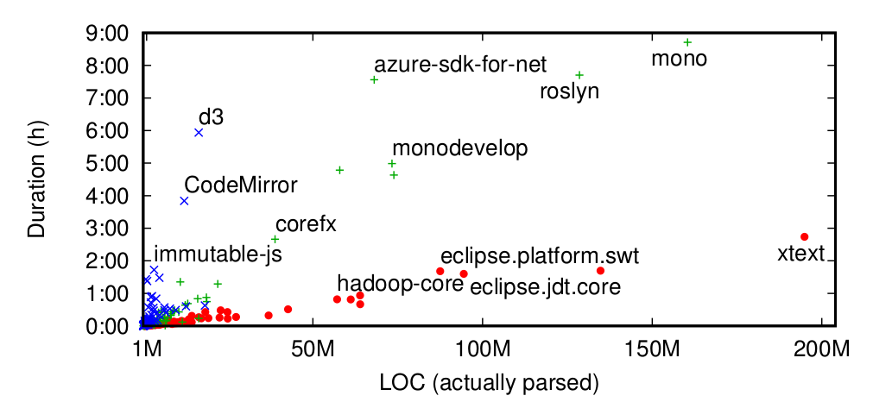
Language matters
Javascript C# Java
E.g.: Javascript takes longer because:
Larger files, less modularization
Slower parser (automatic semicolon-insertion)

Slide 64
LISA is EXTREME
complex
feature-rich
heavyweight
simple
generic
lightweight

Slide 65
Thank you for your attention
Read the paper: | http://t.uzh.ch/Fj
Try the tool: | http://t.uzh.ch/Fk
Get the slides: | http://t.uzh.ch/Fm
Contact me: | alexandru@ifi.uzh.ch
SANER ‘17, Klagenfurt, 22.02.2017

Slide 66
Parallelize Parsing
Single Git tree traversal
src/Main.java | {1: 1251a4}, {3: fc2452}, {4: 251929}
src/Settings.java | {2: fa255a}
src/Foo.java | {1: 512fc2}, {4: 791c2a}, {5: bcb215}
src/Bar.java | {4: 8a23b2}, {5: b2399f}
Obtain sequence of Git blob ids for old versions of each unique path

Slide 67
Parallelize Parsing
Single Git tree traversal
src/Main.java | {1: 1251a4}, {3: fc2452}, {4: 251929}
src/Settings.java | {2: fa255a}
src/Foo.java | {1: 512fc2}, {4: 791c2a}, {5: bcb215}
src/Bar.java | {4: 8a23b2}, {5: b2399f}
Parse files with different paths in parallel
Some files will have more revisions, taking longer to parse in total
→ Parsing only takes roughly as long as required for the file with the most revisions
Obtain sequence of Git blob ids for old versions of each unique path

Slide 68
Parallelize Parsing
Parallel Parsing from Git is easy and has no overhead
Single Git tree traversal
src/Main.java | {1: 1251a4}, {3: fc2452}, {4: 251929}
src/Settings.java | {2: fa255a}
src/Foo.java | {1: 512fc2}, {4: 791c2a}, {5: bcb215}
src/Bar.java | {4: 8a23b2}, {5: b2399f}
Parse files with different paths in parallel
Some files will have more revisions, taking longer to parse in total
→ Parsing only takes roughly as long as required for the file with the most revisions
Obtain sequence of Git blob ids for old versions of each unique path

Slide 69
"Speed-up factor" for each technique
Parallel parsing: Roughly 2
Merged ASTs: >1000 for many revisions
Filtered parsing: >10 during computation, depends on how much is filtered
All depends on file sizes / parser speed

Slide 70
Asynchronous Graph Analysis
rev. 1
Depending on the node type:
- Signal specfic data
rev. 2
rev. 3
rev. 4

Slide 71
Asynchronous Graph Analysis
rev. 1
Depending on the node type:
- Signal specfic data
- Collect specific data
rev. 2
rev. 3
rev. 4

Slide 72
Asynchronous Graph Analysis
rev. 1
Depending on the node type:
- Signal specfic data
- Collect specific data
- Store specific data
rev. 2
rev. 3
rev. 4

Slide 73
Asynchronous Graph Analysis
rev. 1
Depending on the node type:
- Signal specfic data
- Collect specific data
- Store specific data
- Create new nodes & edges
rev. 2
rev. 3
rev. 4

Slide 74
Asynchronous Graph Analysis
rev. 1
Example - Method Count (NOM):
Signal:
Collect:
Store:
Depending on the node type:
- Signal specfic data
- Collect specific data
- Store specific data
- Create new nodes & edges
rev. 2
rev. 3
rev. 4

Slide 75
Asynchronous Graph Analysis
rev. 1
Example - Method Count (NOM):
Signal:
METHOD – nom: 1
Collect:
Store:
Depending on the node type:
- Signal specfic data
- Collect specific data
- Store specific data
- Create new nodes & edges
rev. 2
rev. 3
rev. 4

Slide 76
Asynchronous Graph Analysis
rev. 1
Example - Method Count (NOM):
Signal:
METHOD – nom: 1
Collect:
CLASS-like – nom += s.nom
Store:
Depending on the node type:
- Signal specfic data
- Collect specific data
- Store specific data
- Create new nodes & edges
rev. 2
rev. 3
rev. 4

Slide 77
Asynchronous Graph Analysis
rev. 1
Example - Method Count (NOM):
Signal:
METHOD – nom: 1
Collect:
CLASS-like – nom += s.nom
Store:
CLASS-like – nom
Depending on the node type:
- Signal specfic data
- Collect specific data
- Store specific data
- Create new nodes & edges
rev. 2
rev. 3
rev. 4

Slide 78
Static source code analysis?

Slide 79
Static source code analysis?

Slide 80
Static source code analysis?
Simple Code Metrics
(NOC, NOM, WMC, Complexity, ...)

Slide 81
Static source code analysis?
Simple Code Metrics
(NOC, NOM, WMC, Complexity, ...)
Structure
(Coupling, Inheritance, ...)

Slide 82
Static source code analysis?
Simple Code Metrics
(NOC, NOM, WMC, Complexity, ...)
Structure
(Coupling, Inheritance, ...)

Slide 83
Static source code analysis?
Simple Code Metrics
(NOC, NOM, WMC, Complexity, ...)
Structure
(Coupling, Inheritance, ...)
Practice
code smells refactoring advice
hot-spot detection bug prediction

Slide 84
Static source code analysis?
Simple Code Metrics
(NOC, NOM, WMC, Complexity, ...)
Structure
(Coupling, Inheritance, ...)
Practice
code smells refactoring advice
hot-spot detection bug prediction
Research
understanding software evolution
identifying patterns &
anti-patterns
code quality assessment techniques
...
→ code studies

Slide 85
(Many) existing studies

Slide 86
(Many) existing studies

Slide 87
(Many) existing studies
investigate a small number of projects

Slide 88
(Many) existing studies
investigate a small number of projects
source: github.com
source: openhub.net

Slide 89
(Many) existing studies
investigate a small number of projects
analyze a few snapshots of multi-year projects
v0.7.0
v1.0.0
v1.3.0
v2.0.0
v3.0.0
v3.3.0
v3.5.0
source: github.com
source: openhub.net

Slide 90
(Many) existing studies
investigate a small number of projects
analyze a few snapshots of multi-year projects

Slide 91
(Many) existing studies
investigate a small number of projects
analyze a few snapshots of multi-year projects
focus on very few programming languages

Slide 92
Why?
Only a few projects
Only a few snapshots
Only few Languages

Slide 93
Why?
Only a few projects
Only a few snapshots
Only few Languages
Time & resource intensive analysis

Slide 94
Why?
Only a few projects
Only a few snapshots
Only few Languages
Time & resource intensive analysis
Each commit analyzed seperately

Slide 95
Why?
Only a few projects
Only a few snapshots
Only few Languages
Time & resource intensive analysis
Each commit analyzed seperately
Manual work

Slide 96
Why?
Only a few projects
Only a few snapshots
Only few Languages
Time & resource intensive analysis
Each commit analyzed seperately
Manual work
Many preconditions for analyses

Slide 97
Why?
Only a few projects
Only a few snapshots
Only few Languages
Time & resource intensive analysis
Each commit analyzed seperately
Manual work
Many preconditions for analyses

Slide 98
Why?
Only a few projects
Only a few snapshots
Only few Languages
Time & resource intensive analysis
Each commit analyzed seperately
Manual work
Many preconditions for analyses
Analysis Tools are purpose-built, not designed for large-scale studies

Slide 99
Why?
Only a few projects
Only a few snapshots
Only few Languages
Time & resource intensive analysis
Possible solution: LISA
A fast, multi-purpose, graph-based analysis approach
Each commit analyzed seperately
Manual work
Many preconditions for analyses
Analysis Tools are purpose-built, not designed for large-scale studies

Slide 100
#3: Use asynchronous graph analysis
techniques

Slide 101
Rapid Analysis using LISA
Only a few projects
Only a few snapshots
Only few Languages
Time & resource intensive analysis
Each commit analyzed seperately
Manual work
Many preconditions for analyses
Fast, general purpose code analysis tool aimed specifically at large scale

Slide 102
Rapid Analysis using LISA
Only a few projects
Only a few snapshots
Only few Languages
Time & resource intensive analysis
Analyze all commits in parallel
Manual work
Many preconditions for analyses
Fast, general purpose code analysis tool aimed specifically at large scale

Slide 103
Rapid Analysis using LISA
Only a few projects
Only a few snapshots
Only few Languages
Time & resource intensive analysis
Analyze all commits in parallel
«Point and Shoot»
Many preconditions for analyses
Fast, general purpose code analysis tool aimed specifically at large scale

Slide 104
Rapid Analysis using LISA
Only a few projects
Only a few snapshots
Only few Languages
Time & resource intensive analysis
Analyze all commits in parallel
«Point and Shoot»
Analysis directly on source code
Fast, general purpose code analysis tool aimed specifically at large scale

Slide 105
Rapid Analysis using LISA
Only a few projects
Only a few snapshots
All code is equal
(given a parser)
Time & resource intensive analysis
Analyze all commits in parallel
«Point and Shoot»
Analysis directly on source code
Fast, general purpose code analysis tool aimed specifically at large scale

Slide 106
Rapid Analysis using LISA
Only a few projects
Only a few snapshots
All code is equal
(given a parser)
Quick analysis of 1000s of commits
Analyze all commits in parallel
«Point and Shoot»
Analysis directly on source code
Fast, general purpose code analysis tool aimed specifically at large scale

Slide 107
Rapid Analysis using LISA
Only a few projects
All commits
All code is equal
(given a parser)
Quick analysis of 1000s of commits
Analyze all commits in parallel
«Point and Shoot»
Analysis directly on source code
Fast, general purpose code analysis tool aimed specifically at large scale

Slide 108
Rapid Analysis using LISA
Only a few projects
All commits
All code is equal
(given a parser)
Quick analysis of 1000s of commits
Analyze all commits in parallel
«Point and Shoot»
Analysis directly on source code
Fast, general purpose code analysis tool aimed specifically at large scale

Slide 109
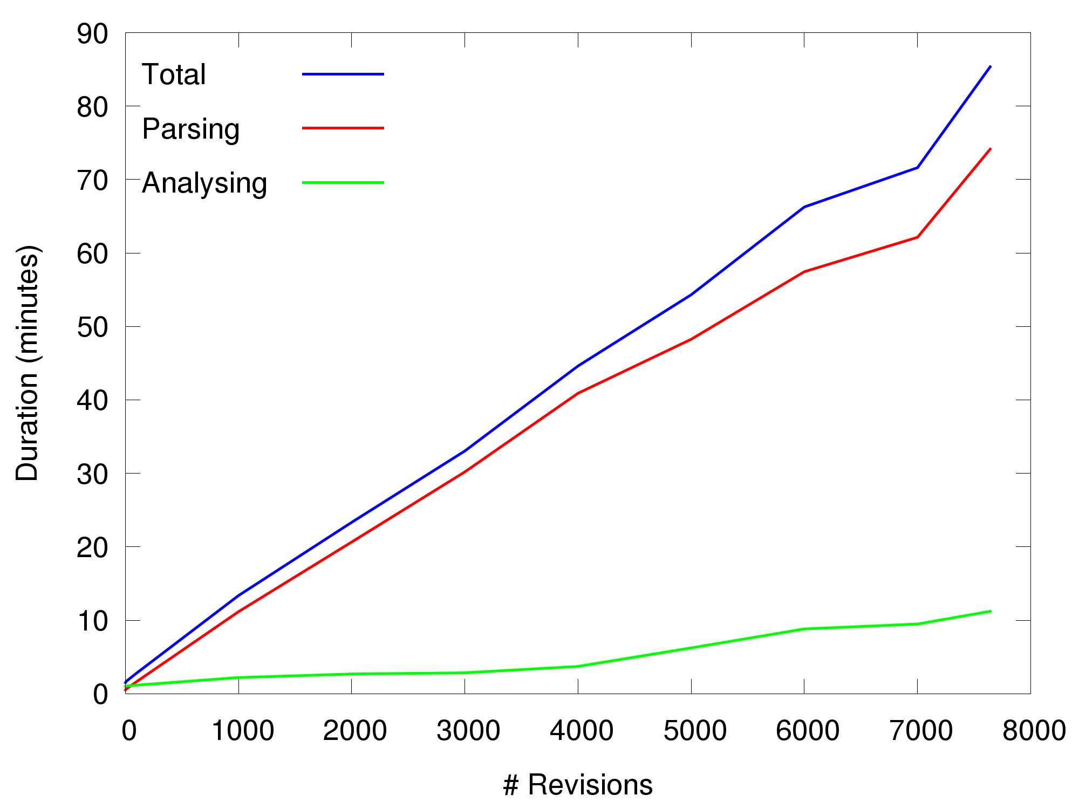
# of Commits: Linear Scaling
March
Update
(Total)

Slide 110
Multi-Project Parallelization
AspectJ:
7642 commits, 440k LOC
Requirements:
20 GB memory
45 min on 4 cores
LISA

Slide 111
Multi-Project Parallelization
AspectJ:
7642 commits, 440k LOC
Requirements:
20 GB memory
45 min on 4 cores
LISA
VM
VM
Parallelization scenario:
10x Amazon EC 2 r3.8xlarge
10x 244GB memory
10x 32 cores
Potential to analyze 160
AspectJ-sized projects per hour
(Most projects on git-hub are much smaller)
VM
VM
VM
VM
VM
VM
VM
VM

Slide 112
Benchmarking

Slide 113
Benchmarking
Here‘s a code smell - should I fix it?
Is this metric too high?
Is this good or bad?
What does it even mean?

Slide 114
Benchmarking

Slide 115
Benchmarking
Create reference points for orientation

Slide 116
Cluster & Compare

Slide 117
Cluster & Compare
Discover „phenotypes“
By metric values

Slide 118
Cluster & Compare
Discover „phenotypes“
By metric values
By metric evolution over time

Slide 119
Cluster & Compare
Discover „phenotypes“
By metric values
By metric evolution over time
Compare programming languages / paradigms

Slide 120
Cluster & Compare
Discover „phenotypes“
By metric values
By metric evolution over time
Compare programming languages / paradigms
Find interesting projects for further study &
identify evolution patterns to find (un-)desirable ones

Slide 121
Machine Learning
Sequence of Changes
(observable)
HMM
Bug Reports
(training)

Slide 122
Machine Learning
Sequence of Changes
(observable)
HMM
Bug Reports
(training)
Bug-Proneness
(hidden)

Slide 123
Machine Learning
Leverage big data to train classifiers and predictors
Sequence of Changes
(observable)
HMM
Bug Reports
(training)
Bug-Proneness
(hidden)

Slide 124
Study Replication
Conclusions X, Y, Z

Slide 125
Study Replication
Conclusions X, Y, Z
Replicable with 1000s of projects?

Slide 126
Study Replication
Conclusions X, Y, Z
Confirmation or rebuttal of existing assumptions
Replicable with 1000s of projects?

