Slide 1
SANER’17
Klagenfurt, Austria
Reducing Redundancies in Multi-Revision Code Analysis
Carol V. Alexandru, Sebastiano Panichella, Harald C. Gall
Software Evolution and Architecture Lab
University of Zurich, Switzerland
{alexandru,panichella,gall}@ifi.uzh.ch
22.02.2017

Slide 2
The Problem Domain
Static analysis (e.g. #Attr., McCabe, coupling...)

Slide 3
The Problem Domain
Static analysis (e.g. #Attr., McCabe, coupling...)
v0.7.0
v1.0.0
v1.3.0
v2.0.0
v3.0.0
v3.3.0
v3.5.0

Slide 4
The Problem Domain
Static analysis (e.g. #Attr., McCabe, coupling...)
Many revisions, fine-grained historical data
v0.7.0
v1.0.0
v1.3.0
v2.0.0
v3.0.0
v3.3.0
v3.5.0

Slide 5
A Typical Analysis Process
select project
www
clone

Slide 6
A Typical Analysis Process
select project
www
clone
select revision
checkout

Slide 7
A Typical Analysis Process
select project
www
clone
select revision
checkout
analysis tool
Res
apply
tool
store
analysis
results

Slide 8
A Typical Analysis Process
select project
www
clone
more revisions?
select revision
checkout
analysis tool
Res
apply
tool
store
analysis
results

Slide 9
A Typical Analysis Process
select project
www
more projects?
clone
more revisions?
select revision
checkout
analysis tool
Res
apply
tool
store
analysis
results

Slide 10
Redundancies all over...
Redundancies in historical code analysis
Impact on Code Study Tools

Slide 11
Redundancies all over...
Redundancies in historical code analysis
Across Revisions
Impact on Code Study Tools
Few files change
Only small parts of a file change

Slide 12
Redundancies all over...
Redundancies in historical code analysis
Across Revisions
Impact on Code Study Tools
Few files change
Repeated analysis of "known" code
Only small parts of a file change

Slide 13
Redundancies all over...
Redundancies in historical code analysis
Across Revisions
Impact on Code Study Tools
Few files change
Repeated analysis of "known" code
Only small parts of a file change
Changes may not even affect results
Storing redundant results

Slide 14
Redundancies all over...
Redundancies in historical code analysis
Across Revisions
Impact on Code Study Tools
Across Languages
Few files change
Repeated analysis of "known" code
Each language has their own toolchain
Only small parts of a file change
Yet they share many metrics
Changes may not even affect results
Storing redundant results

Slide 15
Redundancies all over...
Redundancies in historical code analysis
Across Revisions
Impact on Code Study Tools
Across Languages
Few files change
Repeated analysis of "known" code
Each language has their own toolchain
Only small parts of a file change
Re-implementing identical analyses
Yet they share many metrics
Changes may not even affect results
Generalizability is expensive
Storing redundant results

Slide 16
Redundancies all over...
Redundancies in historical code analysis
Across Revisions
Impact on Code Study Tools
Across Languages
Most tools are specifically made for analyzing 1 revision in 1 language
Few files change
Repeated analysis of "known" code
Each language has their own toolchain
Only small parts of a file change
Re-implementing identical analyses
Yet they share many metrics
Changes may not even affect results
Generalizability is expensive
Storing redundant results

Slide 17
Important!
Techniques implemented in LISA
Your favourite analysis features
Pick what you like!

Slide 18
#1: Avoid Checkouts

Slide 19
Avoid checkouts
clone

Slide 20
Avoid checkouts
clone
checkout
read
write

Slide 21
Avoid checkouts
analyze
clone
read
checkout
read
write

Slide 22
Avoid checkouts
analyze
clone
read
checkout
read
write
For every file: 2 read ops + 1 write op
Checkout includes irrelevant files
Need 1 CWD for every revision to be analyzed in parallel

Slide 23
Avoid checkouts
clone
analyze
read

Slide 24
Avoid checkouts
Only read relevant files in a single read op
No write ops
No overhead for parallization
clone
analyze
read

Slide 25
Avoid checkouts
Only read relevant files in a single read op
No write ops
No overhead for parallization
clone
analyze
Analysis Tool
File Abstraction Layer
Git
read

Slide 26
Avoid checkouts
Only read relevant files in a single read op
No write ops
No overhead for parallization
clone
analyze
Analysis Tool
File Abstraction Layer
Git
read
E.g. for the JDK Compiler:
class JavaSourceFromCharrArray(name: String, val code: CharBuffer)
extends SimpleJavaFileObject(URI.create("string:///" + name), Kind.SOURCE) {
override def getCharContent(): CharSequence = code
}

Slide 27
Avoid checkouts
Only read relevant files in a single read op
No write ops
No overhead for parallization
The simplest time-saver:
If you can - operate directly on bare Git
clone
analyze
Analysis Tool
File Abstraction Layer
Git
read
E.g. for the JDK Compiler:
class JavaSourceFromCharrArray(name: String, val code: CharBuffer)
extends SimpleJavaFileObject(URI.create("string:///" + name), Kind.SOURCE) {
override def getCharContent(): CharSequence = code
}

Slide 28
#2: Use a multi-revision representation
of your sources

Slide 29
Merge ASTs
rev. 1
rev. 2
rev. 3
rev. 4

Slide 30
Merge ASTs
rev. 1
rev. 2
rev. 1
rev. 3
rev. 4

Slide 31
Merge ASTs
rev. 1
rev. 2
rev. 2
rev. 3
rev. 4

Slide 32
Merge ASTs
rev. 1
rev. 2
rev. 3
rev. 3
rev. 4

Slide 33
Merge ASTs
rev. 1
rev. 2
rev. 4
rev. 3
rev. 4

Slide 34
Merge ASTs
rev. 1
rev. 2
rev. 3
rev. 4

Slide 35
Merge ASTs
rev. 1
rev. range [1-4]
rev. 2
rev. 3
rev. range [1-2]
rev. 4

Slide 36
Merge ASTs
rev. 1
rev. 2
rev. 3
rev. 4
AspectJ (~440k LOC):
1 commit: 2.2M nodes
All >7000 commits: 6.5M nodes

Slide 37
Merge ASTs
rev. 1
rev. 2
Merging ASTs brings exponential
space and time savings
rev. 3
rev. 4
AspectJ (~440k LOC):
1 commit: 2.2M nodes
All >7000 commits: 6.5M nodes

Slide 38
Merge ASTs
rev. 1
rev. 2
PS: Analyzing multiple revisions implies building a graph of all revisions first, and analyzing it afterwards
rev. 3
rev. 4
AspectJ (~440k LOC):
1 commit: 2.2M nodes
All >7000 commits: 6.5M nodes

Slide 39
#3: Store AST nodes only if
they're needed for analysis

Slide 40
public class Demo {
public void run() {
for (int i = 1; i< 100; i++) {
if (i % 3 == 0 || i % 5 == 0) {
System.out.println(i)
}
}
}
What's the complexity (1+#forks) and name for each method and class?

Slide 41
public class Demo {
public void run() {
for (int i = 1; i< 100; i++) {
if (i % 3 == 0 || i % 5 == 0) {
System.out.println(i)
}
}
}
What's the complexity (1+#forks) and name for each method and class?
parse
140 AST nodes
(using ANTLR)

Slide 42
public class Demo {
public void run() {
for (int i = 1; i< 100; i++) {
if (i % 3 == 0 || i % 5 == 0) {
System.out.println(i)
}
}
}
What's the complexity (1+#forks) and name for each method and class?
parse
CompilationUnit
TypeDeclaration
Members
Name
Modifiers
Method
Demo
public
Body
Parameters
Name
Modifiers
ReturnType
Statements
...
run
public
PrimitiveType
...
VOID
140 AST nodes
(using ANTLR)

Slide 43
public class Demo {
public void run() {
for (int i = 1; i< 100; i++) {
if (i % 3 == 0 || i % 5 == 0) {
System.out.println(i)
}
}
}
What's the complexity (1+#forks) and name for each method and class?
parse
filtered parse
TypeDeclaration
Method
Name
ForStatement
Name
Demo
IfStatement
run
ConditionalExpression
140 AST nodes
(using ANTLR)
7 AST nodes
(using ANTLR)

Slide 44
public class Demo {
public void run() {
for (int i = 1; i< 100; i++) {
if (i % 3 == 0 || i % 5 == 0) {
System.out.println(i)
}
}
}
What's the complexity (1+#forks) and name for eachmethod and class?
parse
filtered parse
TypeDeclaration
Storing only needed AST nodes applies a manyfold reduction in needed space
Method
Name
ForStatement
Name
Demo
IfStatement
run
ConditionalExpression
140 AST nodes
(using ANTLR)
7 AST nodes
(using ANTLR)

Slide 45
public class Demo {
public void run() {
for (int i = 1; i< 100; i++) {
if (i % 3 == 0 || i % 5 == 0) {
System.out.println(i)
}
}
}
What's the complexity (1+#forks) and name for eachmethod and class?
parse
filtered parse
TypeDeclaration
PS: Which AST nodes to load into the graph depends on the analysis
Method
Name
ForStatement
Name
Demo
IfStatement
run
ConditionalExpression
140 AST nodes
(using ANTLR)
7 AST nodes
(using ANTLR)

Slide 46
#4: Use non-duplicative data structures
to store your results

Slide 47
rev. 1
rev. 2
rev. 3
rev. 4

Slide 48
rev. 1
rev. 2
rev. 3
rev. 4

Slide 49
rev. 1
rev. 2
rev. 3
rev. 4
[1-1]
label
#attr
mcc
[2-3]
label
#attr
mcc
[4-4]
label
#attr
mcc
InnerClass
0
4
1
2
4

Slide 50
rev. 1
rev. 2
Many entities can share the same data across 1000s of revisions
rev. 3
rev. 4
[1-1]
label
#attr
mcc
[2-3]
label
#attr
mcc
[4-4]
label
#attr
mcc
InnerClass
0
4
1
2
4

Slide 51
LISA also does:
#5: Parallel Parsing
#6: Asynchronous graph computation
#7: Generic graph computations
applying to ASTs from compatible
languages

Slide 52
To Summarize...

Slide 53
The LISA Analysis Process
select project
www
clone

Slide 54
The LISA Analysis Process
select project
www
clone
Generates Parser
parallel parse
into merged
graph
determines which AST
nodes are loaded
ANTLRv4
Grammar
Language Mappings
(Grammar to Analysis)
used by

Slide 55
The LISA Analysis Process
select project
www
Async. compute
clone
Res
parallel parse
into merged
graph
store
analysis
results
Generates Parser
runs
on graph
determines which AST
nodes are loaded
determines which
data is persisted
ANTLRv4
Grammar
Language Mappings
(Grammar to Analysis)
Analysis formulated as Graph Computation
used by
used by

Slide 56
The LISA Analysis Process
select project
more projects?
www
Async. compute
clone
Res
parallel parse
into merged
graph
store
analysis
results
Generates Parser
runs
on graph
determines which AST
nodes are loaded
determines which
data is persisted
ANTLRv4
Grammar
Language Mappings
(Grammar to Analysis)
Analysis formulated as Graph Computation
used by
used by

Slide 57
How well does it work, then?

Slide 58
Marginal cost for +1 revision
Seconds
# of revisions

Slide 59
Overall Performance Stats
Language | Java | C# | JavScript
#Projects | 100 | 100 | 100
#Revisions | 646'261 | 489'764 | 204'301
#Files (parsed!) | 3'235'852 | 3'234'178 | 507'612
#Lines (parsed!) | 1'370'998'072 | 961'974'773 | 194'758'719
Total Runtime (RT)¹ | 18:43h | 52:12h | 29:09h
Median RT¹ | 2:15min | 4:54min | 3:43min
Tot. Avg. RT per Rev.² | 84ms | 401ms | 531ms
Med. Avg. RT per Rev.² | 30ms | 116ms | 166ms
¹ Including cloning and persisting results
² Excluding cloning and persisting results

Slide 60
What's the catch?
(There are a few...)

Slide 61
The (not so) minor stuff
Must implement analyses from scratch
No help from a compiler
Non-file-local analyses need some effort

Slide 62
The (not so) minor stuff
Must implement analyses from scratch
No help from a compiler
Non-file-local analyses need some effort
Moved files/methods etc. add overhead
Uniquely identifying files/entities is hard
(No impact on results, though)

Slide 63
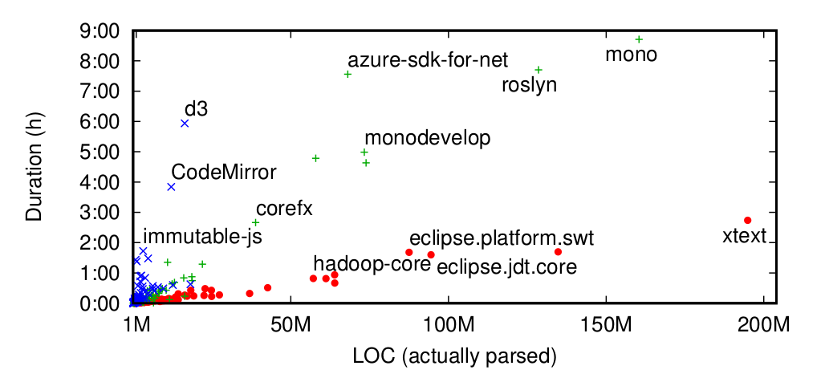
Language matters
Javascript C# Java
E.g.: Javascript takes longer because:
Larger files, less modularization
Slower parser (automatic semicolon-insertion)

Slide 64
LISA is EXTREME
complex
feature-rich
heavyweight
simple
generic
lightweight

Slide 65
Thank you for your attention
Read the paper: | http://t.uzh.ch/Fj
Try the tool: | http://t.uzh.ch/Fk
Get the slides: | http://t.uzh.ch/Fm
Contact me: | alexandru@ifi.uzh.ch
SANER ‘17, Klagenfurt, 22.02.2017

