Slide 1


Slide 2

Quality Management
Please provide us with your feedback regarding the Informatik 1 lecture!
https://qmsl.uzh.ch/de/XELN4 (DE)
https://qmsl.uzh.ch/en/XELN4 (EN)
The links are also provided in the OLAT forum in the post “Course Evaluation”.

Slide 3
Informatik I HS 18
“Live Coding”
Fallout 3 Word Puzzle
Carol Alexandru
Institut für Informatik
http://www.ifi.uzh.ch/seal/teaching/courses/info1.html

Slide 4
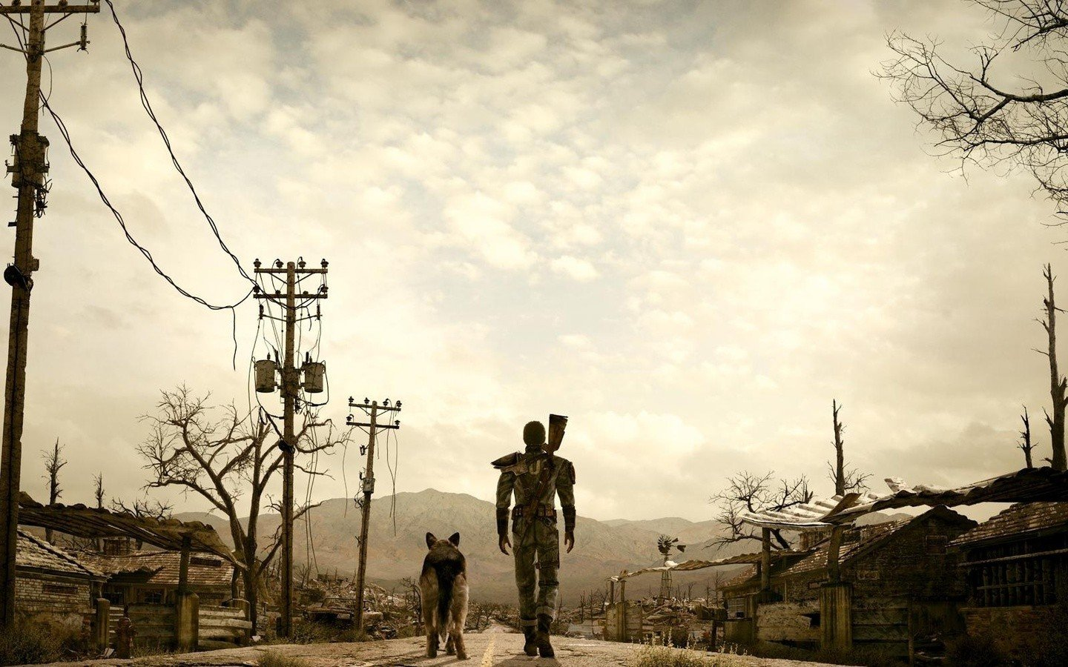

Slide 5
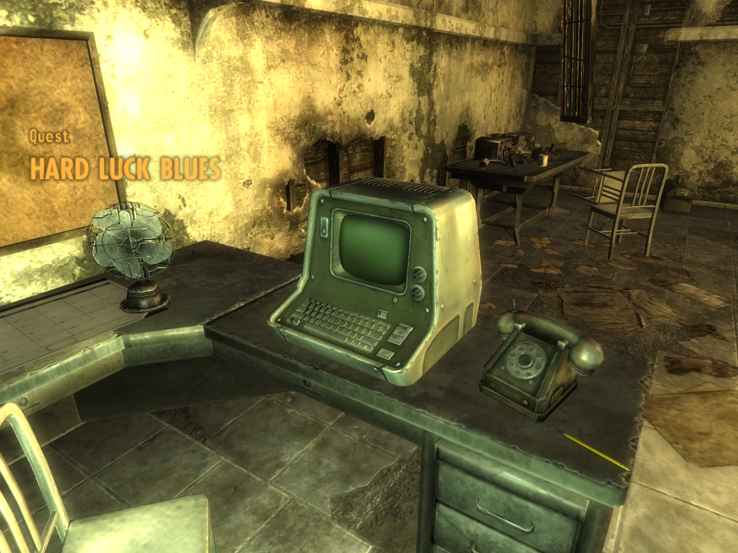

Slide 6
Demo
http://mitchellthompson.net/demos/terminal/

Slide 7
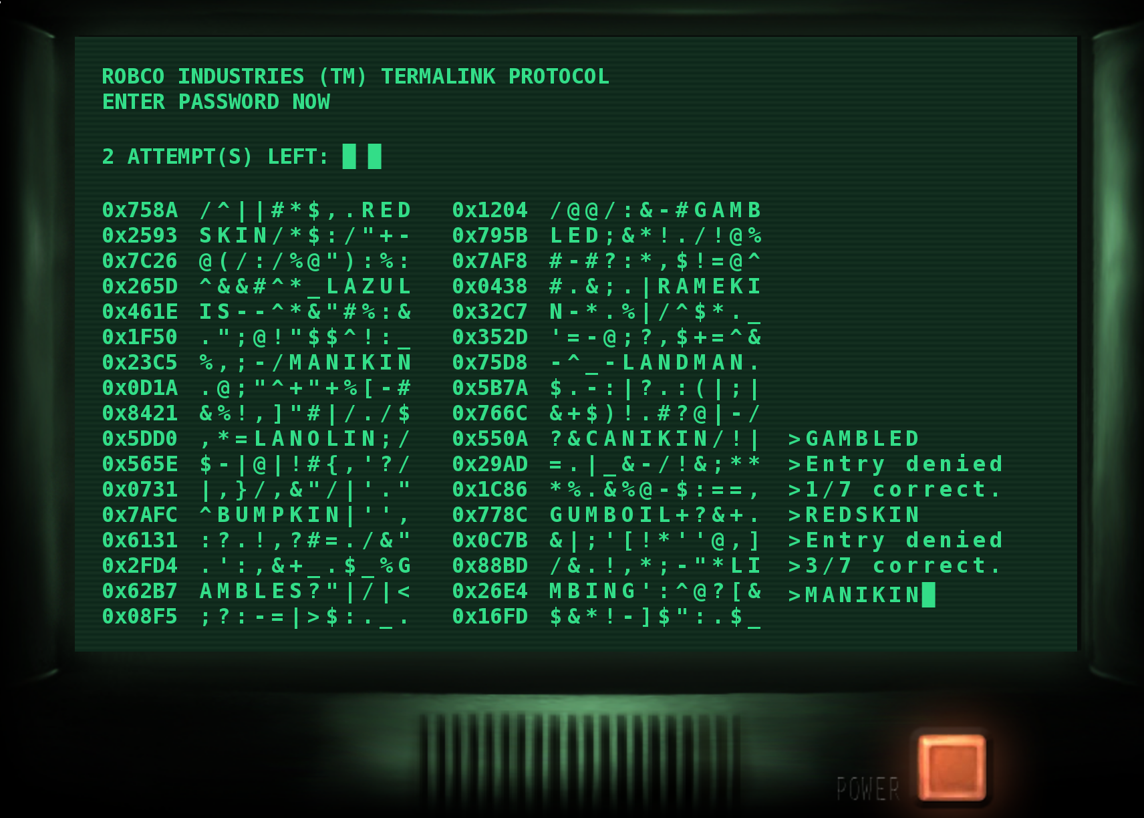
What’s the puzzle? - Understanding functionality

Slide 8
Fallout 3 Word Puzzle: Basic Features
Display n possible passwords

Slide 9
Fallout 3 Word Puzzle: Basic Features
Display n possible passwords
Allow the user to enter a password

Slide 10
Fallout 3 Word Puzzle: Basic Features
Display n possible passwords
Allow the user to enter a password
Process the user-provided password and give feedback:
  Access granted or denied

Slide 11
Fallout 3 Word Puzzle: Basic Features
Display n possible passwords
Allow the user to enter a password
Process the user-provided password and give feedback:
  Access granted or denied
  How many letters of the password match the correct password? (e.g. 2/5)

Slide 12
Fallout 3 Word Puzzle: Basic Features
Display n possible passwords
Allow the user to enter a password
Process the user-provided password and give feedback:
  Access granted or denied
  How many letters of the password match the correct password? (e.g. 2/5)
End the program if
  No more tries left
  Correct password found ✓

Slide 13
Fallout 3 Word Puzzle: Basic Features
Display n possible passwords
Allow the user to enter a password
Process the user-provided password and give feedback:
  Access granted or denied
  How many letters of the password match the correct password? (e.g. 2/5)
End the program if
  No more tries left
  Correct password found

Slide 14
Fallout 3 Word Puzzle: Ingredients
...
berry
mazda
verse
beyond
detail
switch
...
Word list from Internet

Slide 15
Fallout 3 Word Puzzle: Ingredients
...
berry
mazda
verse
beyond
detail
switch
...
TOOL COLD ROWS SOME SHOT MEGA ARMS
> COLD
> 1/4 correct.
> Access denied!
> 3 attempts remaining...
> TOOL
> 4/4 correct.
> Access granted!
Word list from Internet
Game logic
Processing input and giving feedback
Exiting the program eventually

Slide 16
Fallout 3 Word Puzzle: Ingredients
...
berry
mazda
verse
beyond
detail
switch
...
T O O L
C O L D
TOOL COLD ROWS SOME SHOT MEGA ARMS
> COLD
> 1/4 correct.
> Access denied!
> 3 attempts remaining...
> TOOL
> 4/4 correct.
> Access granted!
Word list from Internet
Game logic
Processing input and giving feedback
Exiting the program eventually
Comparing characters of the solution

Slide 17
Fallout 3 Word Puzzle: Ingredients
...
berry
mazda
verse
beyond
detail
switch
...
T O O L
C O L D
TOOL COLD ROWS SOME SHOT MEGA ARMS
> COLD
> 1/4 correct.
> Access denied!
> 3 attempts remaining...
> TOOL
> 4/4 correct.
> Access granted!
Word list from Internet
Game logic
Processing input and giving feedback
Exiting the program eventually
Comparing characters of the solution
Functionality

Slide 18
Fallout 3 Word Puzzle: Ingredients
...
berry
mazda
verse
beyond
detail
switch
...
T O O L
C O L D
TOOL COLD ROWS SOME SHOT MEGA ARMS
> COLD
> 1/4 correct.
> Access denied!
> 3 attempts remaining...
> TOOL
> 4/4 correct.
> Access granted!
Word list from Internet
Game logic
Processing input and giving feedback
Exiting the program eventually
Comparing characters of the solution
Decorative components
Random characters
History formatting
Functionality

Slide 19
Fallout 3 Word Puzzle: Ingredients
...
berry
mazda
verse
beyond
detail
switch
...
T O O L
C O L D
TOOL COLD ROWS SOME SHOT MEGA ARMS
> COLD
> 1/4 correct.
> Access denied!
> 3 attempts remaining...
> TOOL
> 4/4 correct.
> Access granted!
Word list from Internet
Game logic
Processing input and giving feedback
Exiting the program eventually
Comparing characters of the solution
Decorative components
Random characters
History formatting
Functionality
User Interface

Slide 20
Functionality, Part 1: Getting the words
...
berry
mazda
verse
beyond
detail
switch
...
Read word list

Slide 21
Functionality, Part 1: Getting the words
...
berry
mazda
verse
beyond
detail
switch
...
Read word list
Filter for words with correct length

Slide 22
Functionality, Part 1: Getting the words
...
berry
mazda
verse
beyond
detail
switch
...
...
berry
mazda
verse
clear
james
linux
...
Read word list
Filter for words with correct length

Slide 23
Functionality, Part 1: Getting the words
...
berry
mazda
verse
beyond
detail
switch
...
...
berry
mazda
verse
clear
james
linux
...
berry
mazda
verse
clear
Read word list
Filter for words with correct length
Pick n words to show

Slide 24
Functionality, Part 1: Getting the words
...
berry
mazda
verse
beyond
detail
switch
...
...
berry
mazda
verse
clear
james
linux
...
berry
mazda
verse
clear
Read word list
Filter for words with correct length
Pick n words to show
Pick one of these to be the password

Slide 25

Functionality, Part 1: Getting the words
...
berry
mazda
verse
beyond
detail
switch
...
...
berry
mazda
verse
clear
james
linux
...
berry
mazda
verse
clear
Read word list
Filter for words with correct length
Pick n words to show
Pick one of these to be the password

Slide 26
Functionality, Part 2: Basic interaction
TOOL COLD ROWS SOME SHOT MEGA ARMS
> COLD
> Access denied!
> 3 attempts remaining...
> TOOL
> Access granted!
  Show choices
While attempts is not 0:
  Reading user input
  Check if password is correct
  Exit program if password correct

Slide 27
Functionality, Part 2: Basic interaction
TOOL COLD ROWS SOME SHOT MEGA ARMS
> COLD
> Access denied!
> 3 attempts remaining...
> TOOL
> Access granted!
  Show choices
While attempts is not 0:
  Reading user input
  Check if password is correct
  Exit program if password correct

Slide 28
Functionality, Part 2: More feedback!
TOOL COLD ROWS SOME SHOT MEGA ARMS
> COLD
> 1/4 correct.
> Access denied!
> 3 attempts remaining...
> TOOL
> 4/4 correct.
> Access granted!
  Show choices
While attempts is not 0:
  Reading user input
  Check if password is correct
  Show how many characters are correct
  Exit program if password correct

Slide 29
Functionality, Part 2: Comparing characters?
T O O L
C O L D
  In English:
    For every character index from 0 to how long the password is, compare the characters in guess and password, and increment a counter if they match
Password
Guess

Slide 30
Functionality, Part 2: Comparing characters?
T O O L
C O L D
  In English:
    For every character index from 0 to how long the password is, compare the characters in guess and password, and increment a counter if they match
  In python:
    matching = 0
    for i in range(length):
    if guess[i] == password[i]: matching += 1
Password
Guess

Slide 31
Functionality, Part 2: Comparing characters?
T O O L
C O L D
  In English:
    For every character index from 0 to how long the password is, compare the characters in guess and password, and increment a counter if they match
  In python:
    matching = 0
    for i in range(length):
    if guess[i] == password[i]: matching += 1
Password
Guess

Slide 32

Functionality: done!
T O O L
C O L D
...
berry
mazda
verse
beyond
detail
switch
...
TOOL COLD ROWS SOME SHOT MEGA ARMS
> COLD
> 1/4 correct.
> Access denied!
> 3 attempts remaining...
> TOOL
> 4/4 correct.
> Access granted!
Comparing characters of the solution
Word list from Internet
Game logic
Processing input and giving feedback
Exiting the program eventually

Slide 33
Now the hard part: the user interface!

Slide 34
Fallout 3 Word Puzzle: UI
Header text

Slide 35
Fallout 3 Word Puzzle: UI
Header text
Attempts counter

Slide 36
Fallout 3 Word Puzzle: UI
Header text
Attempts counter
Random ‘hex codes’

Slide 37
Fallout 3 Word Puzzle: UI
Header text
Attempts counter
Random ‘hex codes’
Passwords embedded in random ‘garbage’ text

Slide 38
Fallout 3 Word Puzzle: UI
Header text
Attempts counter
Random ‘hex codes’
Passwords embedded in random ‘garbage’ text
History

Slide 39
Fallout 3 Word Puzzle: UI
Header text
Attempts counter
Random ‘hex codes’
Passwords embedded in random ‘garbage’ text
History, including:
  Previously entered guesses

Slide 40
Fallout 3 Word Puzzle: UI
Header text
Attempts counter
Random ‘hex codes’
Passwords embedded in random ‘garbage’ text
History, including:
  Previously entered guesses
  Access denied/granted

Slide 41
Fallout 3 Word Puzzle: UI
Header text
Attempts counter
Random ‘hex codes’
Passwords embedded in random ‘garbage’ text
History, including:
  Previously entered guesses
  Access denied/granted
  Feedback (x/y correct)

Slide 42
UI, Part 0: Separation of concerns
What if we want to use the same UI for a different but similar game?
What if we want to play the same game but with a different UI?

Slide 43
UI, Part 0: Separation of concerns
What if we want to use the same UI for a different but similar game?
What if we want to play the same game but with a different UI?
Game Logic | User interaction

Slide 44
UI, Part 0: Separation of concerns
What if we want to use the same UI for a different but similar game?
What if we want to play the same game but with a different UI?
Game Logic | User interaction
Which words should be selected and displayed?
Which is the correct password?
How many attempts are left?
How many characters were correctly guessed?

Slide 45
UI, Part 0: Separation of concerns
What if we want to use the same UI for a different but similar game?
What if we want to play the same game but with a different UI?
Game Logic | User interaction
Which words should be selected and displayed? | Printing the words and feedback on screen
Which is the correct password? | Accepting user input
How many attempts are left? | Styling and Layout
How many characters were correctly guessed?

Slide 46
UI, Part 0: Separation of concerns
What if we want to use the same UI for a different but similar game?
What if we want to play the same game but with a different UI?
Game Logic | User interaction
Which words should be selected and displayed? | Printing the words and feedback on screen
Which is the correct password? | Accepting user input
How many attempts are left? | Styling and Layout
How many characters were correctly guessed?
→ Let’s refactor the existing code to go into 2 separate classes!

Slide 47
UI, Part 1: Header section and ‘print_screen()’
UI drawing options:
  Redraw entire screen
    Easy to program, inefficient

Slide 48
UI, Part 1: Header section and ‘print_screen()’
UI drawing options:
  Redraw entire screen
    Easy to program, inefficient
  Redraw only parts that change
    Hard to program, more efficient
Typically a mix of both is applied

Slide 49
UI, Part 1: Header section and ‘print_screen()’
UI drawing options:
  Redraw entire screen
    Easy to program, inefficient
  Redraw only parts that change
    Hard to program, more efficient
Typically a mix of both is applied
This is true for all UIs, e.g.
  Web browser
  3D games
  Mobile phone interface

Slide 50
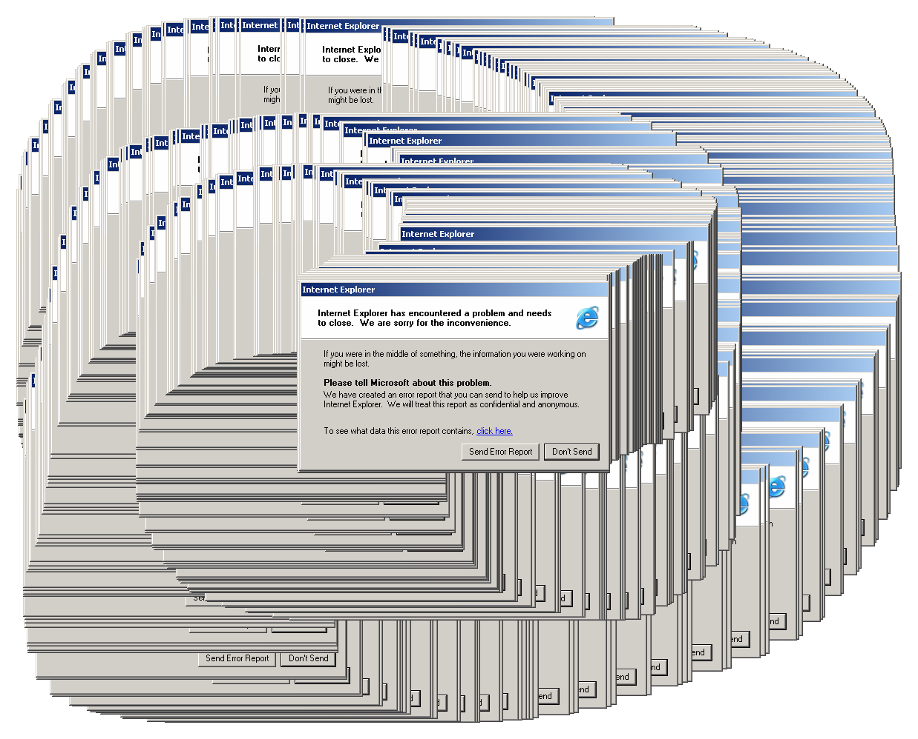

Slide 51
UI, Part 1: Header section and ‘print_screen()’
The program main loop will:
  Call print_screen() to:
    Print the header
    Print the attempts counter
    Print the hex codes and code lines
    Print the history
    Print a prompt

Slide 52
UI, Part 1: Header section and ‘print_screen()’
The program main loop will:
  Call print_screen() to:
    Print the header
    Print the attempts counter
    Print the hex codes and code lines
    Print the history
    Print a prompt
  Wait for user input (ENTER/RETURN)

Slide 53
UI, Part 1: Header section and ‘print_screen()’
The program main loop will:
  Call print_screen() to:
    Print the header
    Print the attempts counter
    Print the hex codes and code lines
    Print the history
    Print a prompt
  Wait for user input (ENTER/RETURN)
  Add the user input to history

Slide 54
UI, Part 1: Header section and ‘print_screen()’
The program main loop will:
  Call print_screen() to:
    Print the header
    Print the attempts counter
    Print the hex codes and code lines
    Print the history
    Print a prompt
  Wait for user input (ENTER/RETURN)
  Add the user input to history
  Call the game logic to check the guess

Slide 55
UI, Part 1: Header section and ‘print_screen()’
The program main loop will:
  Call print_screen() to:
    Print the header
    Print the attempts counter
    Print the hex codes and code lines
    Print the history
    Print a prompt
  Wait for user input (ENTER/RETURN)
  Add the user input to history
  Call the game logic to check the guess
  Add the logic feedback to history
  Exit if guess correct, else repeat…

Slide 56
UI, Part 1: Header section and ‘print_screen()’
The program main loop will:
  Call print_screen() to:
    Print the header
    Print the attempts counter
    Print the hex codes and code lines
    Print the history
    Print a prompt
  Wait for user input (ENTER/RETURN)
  Add the user input to history
  Call the game logic to check the guess
  Add the logic feedback to history
  Exit if guess correct, else repeat…

Slide 57
UI, Part 2: Generating hex codes
What do we need?
  “0x” every time
  4 digits after that
  17 rows, 2 columns = 34 in total

Slide 58
UI, Part 2: Generating hex codes
What do we need?
  “0x” every time
  4 digits after that
  17 rows, 2 columns = 34 in total
For simplicity, we will generate “0x0000” columns*rows times

Slide 59
UI, Part 2: Generating hex codes
What do we need?
  “0x” every time
  4 digits after that
  17 rows, 2 columns = 34 in total
For simplicity, we will generate “0x0000” columns*rows times
Generating random hex codes left as an exercise for you :)

Slide 60
UI, Part 3: Generating “code”
What do we need?
  The words separated (padded) by random characters
  Split into pieces

Slide 61
UI, Part 3: Generating “code”
What do we need?
  The words separated (padded) by random characters
  Split into pieces
Total size:
  line width * columns * rows

Slide 62
UI, Part 3: Generating “code”
What do we need?
  The words separated (padded) by random characters
  Split into pieces
Total size:
  line width * columns * rows
Total padding size:
  total - length of words

Slide 63
UI, Part 3: Generating “code”
What do we need?
  The words separated (padded) by random characters
  Split into pieces
Total size:
  line width * columns * rows
Total padding size:
  total - length of words
Individual padding size:
  Total padding / #words + 1

Slide 64
UI, Part 3: Generating “code”
What do we need?
  The words separated (padded) by random characters
  Split into pieces
Total size:
  line width * columns * rows
Total padding size:
  total - length of words
Individual padding size:
  Total padding / #words + 1

Slide 65
UI, Part 4: Formatting
What do we need?
  Print hex codes
  Print lines
  Print history

Slide 66
UI, Part 4: Formatting
What do we need?
  Print hex codes
  Print lines
  Print history
But: The terminal prints line by line!

Slide 67
UI, Part 4: Formatting
What do we need?
  Print hex codes
  Print lines
  (Print history)
But: The terminal prints line by line!
For every row, print correct parts of the complete output
  Hex + code + Hex + code (+ history)

Slide 68
UI, Part 4: Formatting
What do we need?
  Print hex codes
  Print lines
  (Print history)
But: The terminal prints line by line!
For every row, print correct parts of the complete output
  Hex + code + Hex + code (+ history)

Slide 69
UI, Part 4: Formatting (cont.)
Printing the history
  Only print as many history lines as there are rows of hex/code
  If there is not enough history, print nothing there
  Latest history at the bottom
  Last line should not have a newline

Slide 70
UI, Part 4: Formatting (cont.)
Printing the history
  Only print as many history lines as there are rows of hex/code
  If there is not enough history, print nothing there
  Latest history at the bottom
  Last line should not have a newline

Slide 71
Future work

Slide 72
More things to do!
Exercise 11
  Random hex codes
  More fun choice of words (more shared characters)
  Alternative game rules

Slide 73
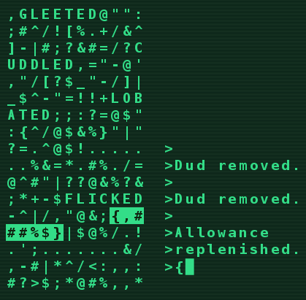
More things to do!
Exercise 11
  Random hex codes
  More fun choice of words (more shared characters)
  Alternative game rules
And furthermore…
  Removal of duds / replenishing allowance

Slide 74
More things to do!
Exercise 11
  Random hex codes
  More fun choice of words (more shared characters)
  Alternative game rules
And furthermore…
  Removal of duds / replenishing allowance
  Moving the cursor instead of redrawing the entire screen
    Using terminal commands or ncurses
  Different UI (for example using Kivy)

Slide 75
Some advice for the exam and the future
Learning by doing
  Write your own programs from scratch!
    No copying from friends
    No «reading and understanding» without any writing
  Keep practicing, solve small problems
    Write a text-based adventure game
    Write a simple, interactive calculator ( + - / * etc.)
    Solve the exercises by yourself! (And don’t memorize them)
It’s hard for everyone in the beginning, just keep practicing!

Slide 76
Informatik I Live Coding
Thanks for your attention and good luck!

Slide 77
Quality Management
Please provide us with your feedback regarding the Informatik 1 lecture!
https://qmsl.uzh.ch/de/XELN4 (DE)
https://qmsl.uzh.ch/en/XELN4 (EN)
The links are also provided in the OLAT forum in the post “Course Evaluation”.

