Slide 1
Overview
Map/Reduce overview
Local debug setup
Pseudo-distributed setup
The assignment tasks

Slide 2
Map/Reduce Overview
What is Map/Reduce:
MapReduce is a software framework for processing large data sets in a distributed fashion over several machines.
What is HDFS:
The Hadoop Distributed File System (HDFS) is a distributed file system designed to run on commodity hardware.
Relax some requirements of traditional distributed FS, but ensure high availability.

Slide 3
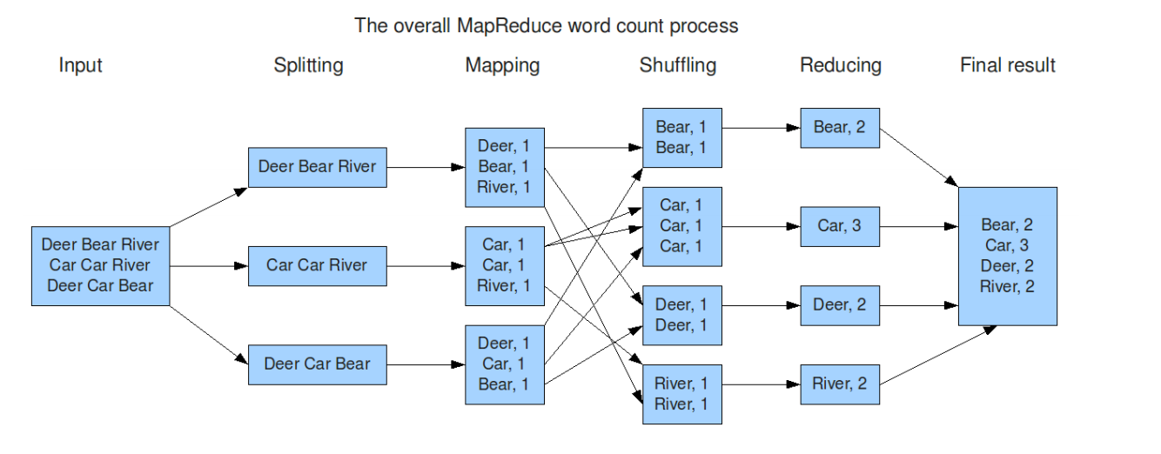
Map/Reduce Overview

Slide 4
Map/Reduce Overview
Input and output are always in (key, value) pairs. Need to be carefully assigned.
Moving program to data.
Job1
Job4
Job2
Job3
Job5

Slide 5
At IFI
Hadoop Cluster (80+ machines)
http://tentacle.ifi.uzh.ch:8088/cluster/nodes
Typical workflow:
Develop your app in local
Upload it to the submission host
Submit it with the submission host

Slide 6
Debug Setup
Include related jars! As long as you include the related jars, you will be able to run and debug it in local. You can even setup a break point.
Write your java application.
Set up run arguments.
Press the run button.

Slide 7
Mapper
public void map(Object key, Text value, Context context)
throws IOException, InterruptedException {
String line = value.toString();
line = line.replaceAll(",", "");
line = line.replaceAll("\\.", "");
line = line.replaceAll("-", " ");
line = line.replaceAll("\"", "");
StringTokenizer tokenizer = new StringTokenizer(line);
int movieId = Integer.parseInt(tokenizer.nextToken());
while (tokenizer.hasMoreTokens()) {
String word = tokenizer.nextToken().toLowerCase();
context.write(new Text("1"), new IntWritable(1));
}
}
Only one key here “1”

Slide 8
Reducer
public void reduce(Text key, Iterable<IntWritable> values, Context context)
throws IOException, InterruptedException {
int sum = 0;
for (IntWritable val : values) {
sum++;
}
context.write(new IntWritable(sum), NullWritable.get());
}
For the only key “1”, count the number of its values

Slide 9
Assignment 2
There are 4 tasks:
1: Count the total number of words in plot_summaries.txt. (Almost done for you)
2.1: Get the top 10 most frequently used words from plot_summaries.txt in descending order.
2.2: Same with 2.1, but excluding stop words.
3: Join movie.metadata.tsv and character.metadata.tsv to find actors/actresses in each movie.
4: Build an inverted index of the words for the movies in plot_summaries.txt.

Slide 10
Pseudo-distributed Setup
The HortonWorks Sandbox is a pseudo-distributed cluster running HDFS, Hadoop, pig and other big data tools. Once it is loaded by your virtual machine, you can assume all these services are running on the server.
Import the virtual image.
Using a browser to access the server
Using command line to access the server
Upload your jar
Submit your jar

Slide 11
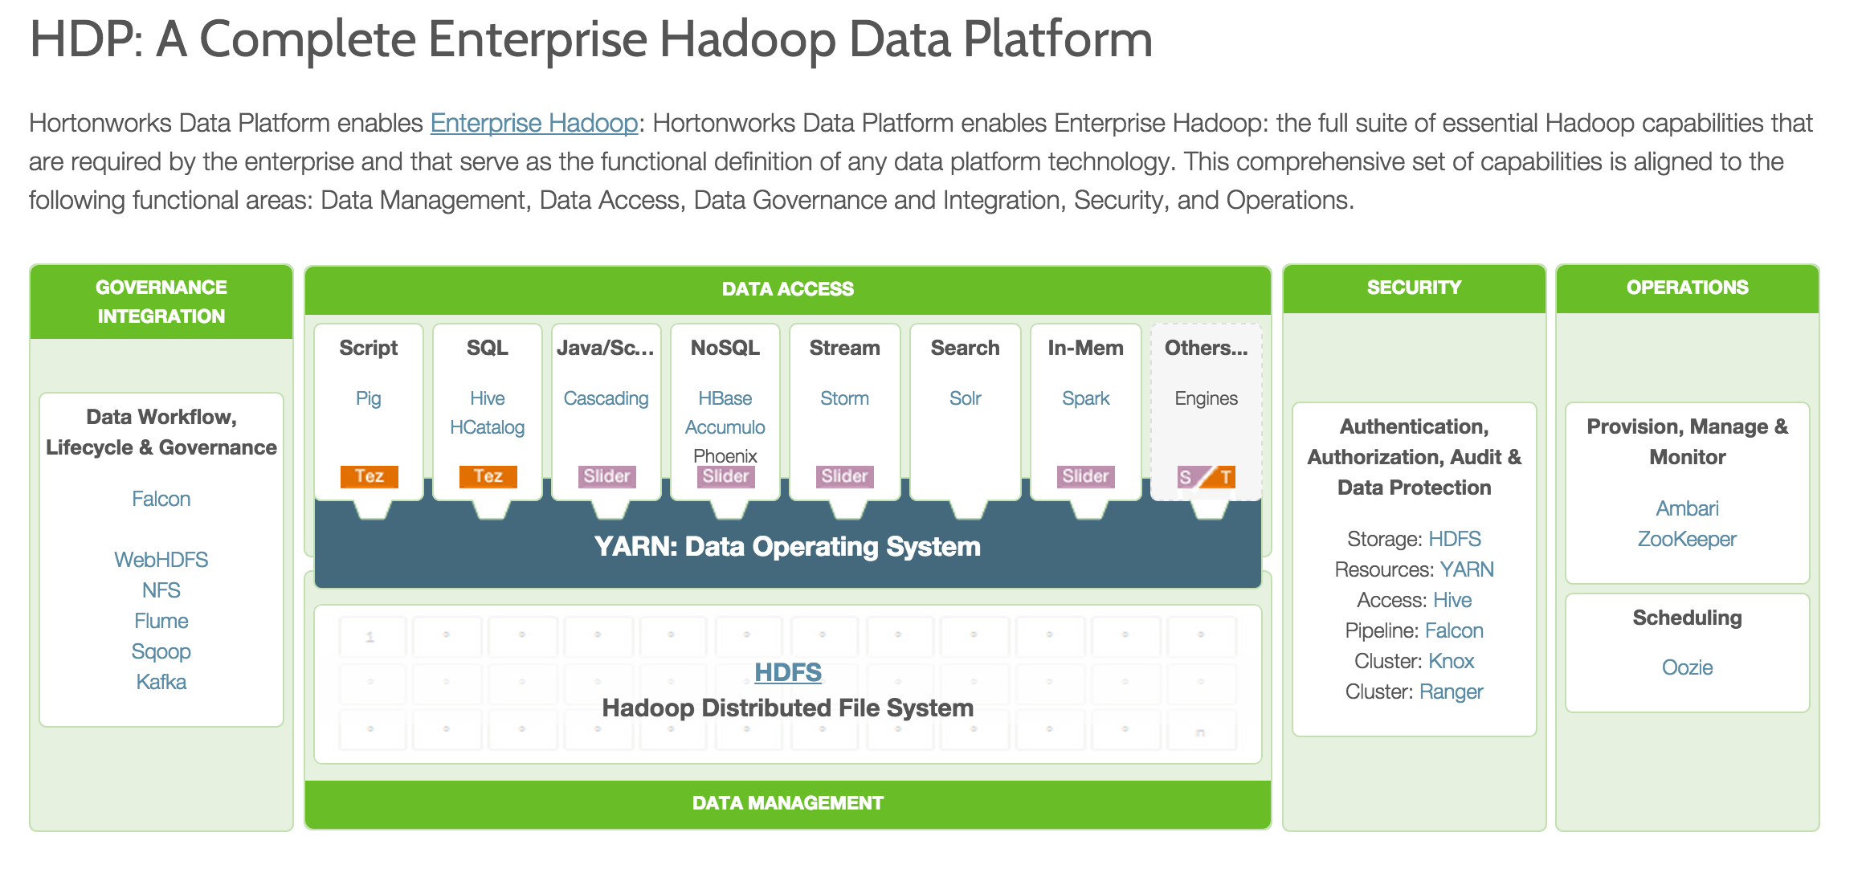
Overview

Slide 12
Hortonworks Data Platform
Connect to server
ssh hue@127.0.0.1 -p 2222
hadoop
Browser-based interface
File browser
Job browser
Pig

